Slide 2
OVERVIEW OF AGILE DEVELOPMENT
“I am a firm believer in the people. If given the truth, they can be depended upon to meet any challenge. The great point is to bring them the real facts.”
Abraham Lincoln

Slide 3








OVERVIEW OF AGILE METHODOLOGY
AGENDA
Agile Development Methodoly
Original SCRUM framework
Sumary & Discussion

Slide 4
OVERVIEW OF AGILE METHODOLOGY
WARM UP
 | True | False
Agile teams do very little planning
Agile is not suited for fixed bid projects
Models like PMI and PRINCE2 are more suited to high-risk projects than agile
Developers do not have the people skills needed to talk to customers
Moving people between projects helps spread expertise and improves the organization
Agile teams don’t create documentation
Some people need to be told what to do
Scrum meetings be replaced by emailed status reports
In SCRUM, we can change anytime we want

Slide 5

AGILE DEVELOPMENT MOTHODOLOGY
“…as in Rugby, the ball gets passed within the team as it moves as a unit up the field.
Takeuchi-Nonaka

Slide 6


AGILE DEVELOPMENT METHODOLOGY
PROCESS ‘S Mindset

Slide 7
AGILE DEVELOPMENT METHODOLOGY
Agility
The ability to rapidly and deliberately respond to changing demand, while controlling risk.
Flexibility, the capacity and capability of rapidly and efficiently adapting.

Slide 8

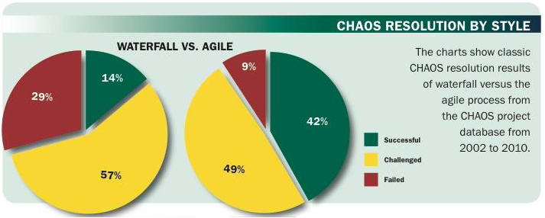
AGILE DEVELOPMENT METHODOLOGY
Where Are We with Agility?
Source: The CHAOS Manifesto, Copyright 2011

Slide 9

AGILE DEVELOPMENT METHODOLOGY
The Right Process Produces The Right Results
“The agile process is the universal remedy for software development project failure. Software applications developed through the agile process have three times the success rate of the traditional waterfall method and a much lower percentage of time and cost overruns. The secret is the trial and error and delivery of the iterative process.”
Source: The CHAOS Manifesto, Copyright 2011

Slide 10

AGILE DEVELOPMENT METHODOLOGY
Brief History of Development Methodologies
1999
Agile, e.g. XP (Kent Beck)
1998
RUP (Rational)
1991
RAD (James Martin)
1985
Spiral Model (Barry Boehm)
1980
V-Model (Anon)
1970
Waterfall (Royce)

Slide 11
AGILE DEVELOPMENT METHODOLOGY
Agile Manifesto
Individuals & Interactions
Processes &
Tools
OVER
Working
Software
Comprehensive Documentation
OVER
Customer Collaboration
OVER
Contract Negotiation
Responding to Change
OVER
Following a
Plan
Source: http://www.agilemanifesto.org/

Slide 12
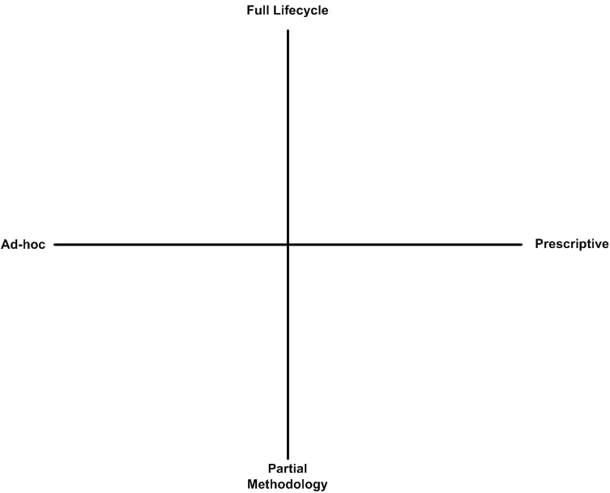
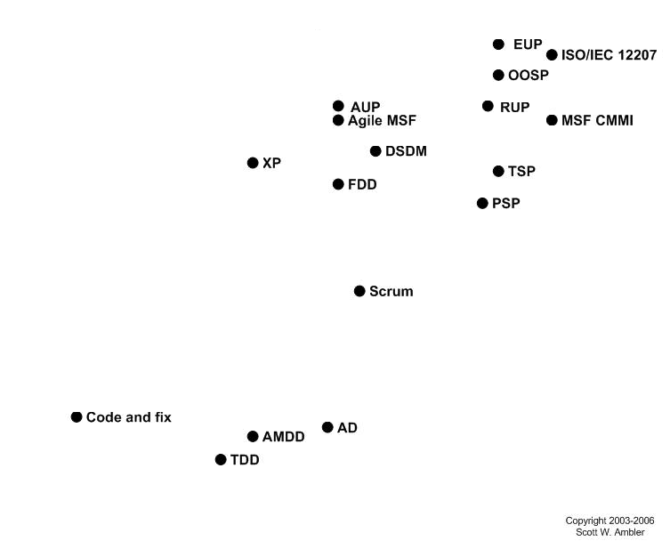

AGILE DEVELOPMENT METHODOLOGY
AGILE MODEL SERIES

Slide 13
ORIGINAL SCRUM FRAMEWORK
“A man who carries a cat by the tail learns something he can learn in no other way.
- Mark Twain

Slide 14

ORIGINAL SCRUM FRAMEWORK
Scrum: Framework, Not Methodology
A tool used to learn to build higher quality software with a better return on investment
Does not provide the answers to most problems
Not a methodology
Simply a framework
Not a silver bullet

Slide 15
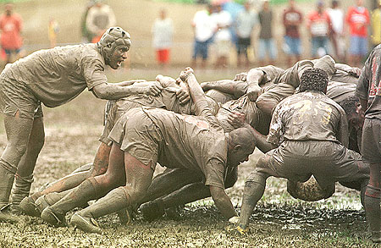
ORIGINAL SCRUM FRAMEWORK
Scrum: What’s In A name?

Slide 16
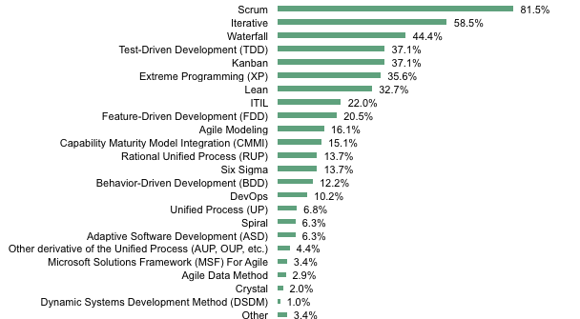
ORIGINAL SCRUM FRAMEWORK
Scrum Is A Common Development Approach
Source: November 2011 Global Agile Software Application Development Online Survey
Base: 205 organizations who are implementing or have implemented Agile
(multiple responses accepted)

Slide 17




ORIGINAL SCRUM FRAMEWORK
Scrum Is A Tool Used To Become Agile
Plan | Analyze | Review
 | Design
 | Code
 | Test
 | Release
Scrum: Short, high value iterations that deliver valuable, opportunistic pieces of functionality
Work is done by self-organizing, cross-functional teams.
Highly productive, creative, and delivering high quality product.

Slide 18
ORIGINAL SCRUM FRAMEWORK
Scrum Has Three Legs
Transparency
Inspection
Adaptation

Slide 19
ORIGINAL SCRUM FRAMEWORK
3 Types Of Content In Scrum
Roles
Artifacts
Events
Product Owner
Development Team
Scrum Master
Increment
Product Backlog
Sprint Backlog
Sprint
Sprint Planning
Daily Scrum
Sprint Review
Retrospective

Slide 20

ORIGINAL SCRUM FRAMEWORK
Roles: Each One Has A Specific Responsibility
Development Team
Manages itself
Product Owner
Optimizes value of the Product
Scrum Master
Manages the Scrum Process
Delivers Done Increments
Manages the Product Backlog
Removes Impediments

Slide 21
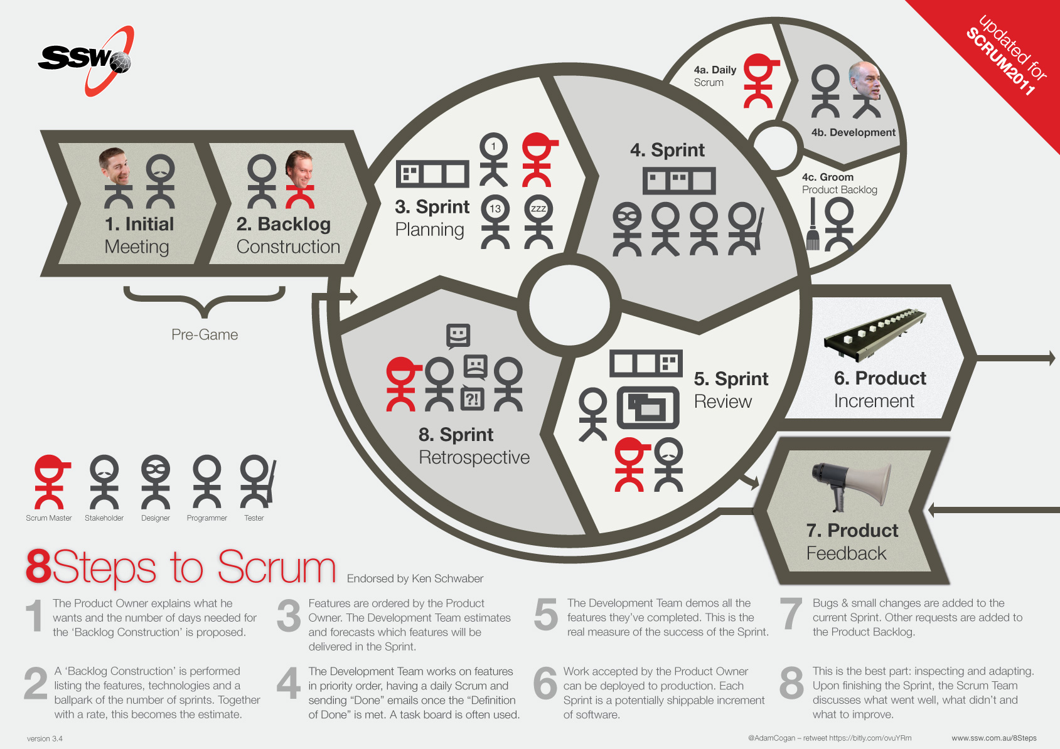
ORIGINAL SCRUM FRAMEWORK
Roles, Artifacts & Events In Action

Slide 22

ORIGINAL SCRUM FRAMEWORK
How Is Scrum Empirical?
Event | Inspection | Adaptation
Sprint Planning | Product Backlog | Goal, Sprint Backlog
Daily Scrum | Progress to date | Sprint Backlog
Sprint Review | Increment, Sprint, Product Backlog | Product Backlog
Retrospective | Process of Sprint | Actionable and committed improvements

Slide 23

ORIGINAL SCRUM FRAMEWORK
WHAT ‘S PRODUCT BACKLOG?
The Product Backlog is an ordered list of everything that might be needed in the product.
The Product Owner is responsible for the Product Backlog, including its content, availability, and ordering.
The Product Backlog evolves as the product and the environment in which it will be used evolves.
The Product Backlog is often ordered by value, risk, priority, and necessity
Higher ordered Product Backlog items are clearer and more detailed than lower ordered ones

Slide 24
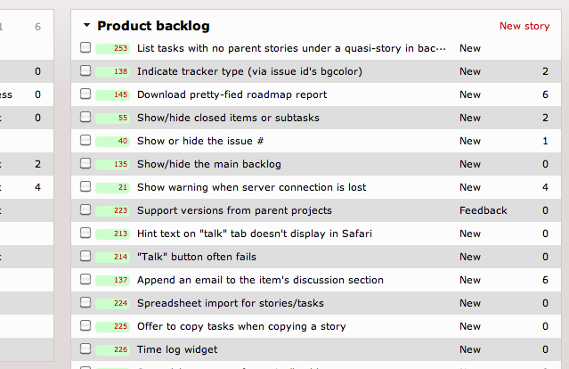
ORIGINAL SCRUM FRAMEWORK
PRODUCT BACKLOG SAMPLE

Slide 25
ORIGINAL SCRUM FRAMEWORK
How Is Scrum Iterative?
Sprints are time-boxed iterations
All development is done within Sprint
A Sprint has a constant duration of 1 month or less
During the Sprint:
No changes are made that would affect the Sprint Goal;
Development Team composition;
Quality goals remain constant;
Scope may be clarified and re-negotiated between the Product Owner and Development Team as more is learned.
Sprint Planning Meeting, Daily Scrums, the development work, Sprint Review Meeting, and Sprint Retrospective

Slide 26
ORIGINAL SCRUM FRAMEWORK
Sprint Planning Meeting
The work to be performed in the Sprint is planned at the Sprint Planning Meeting.
This plan is created by the collaborative work of the entire Scrum Team.
The Sprint Planning Meeting is time-boxed to eight hours for a one-month Sprint.
The Sprint Planning Meeting consists of two parts
Part 1 : What will be delivered in the Increment resulting from the upcoming Sprint?
Part 2 : How will the work needed to deliver the Increment be achieved?

Slide 27
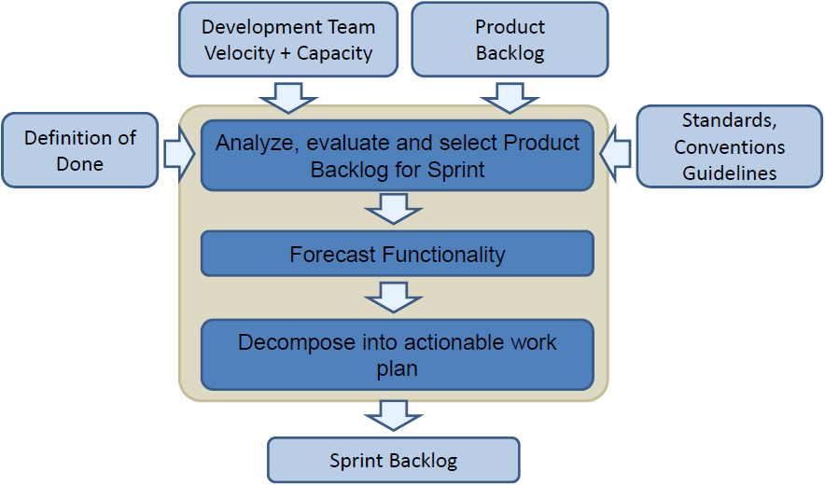
ORIGINAL SCRUM FRAMEWORK
Sprint Planning Meeting Flow

Slide 28
ORIGINAL SCRUM FRAMEWORK
Sprint Planning Meeting (part 1)
Purpose: To identify the Product Backlog that will most likely be worked on during the Sprint
Outcome: Sprint Goal
Activities:
Product Owner presents the ordered Product Backlog.
The Development Team works with the Product Owner until it understands the Product Backlog.
Analysis & decomposition may be required.
The Development Team selects Product Backlog items it believes can be delivered in the upcoming Sprint. This is a forecast.
A Sprint Goal is crafted.

Slide 29
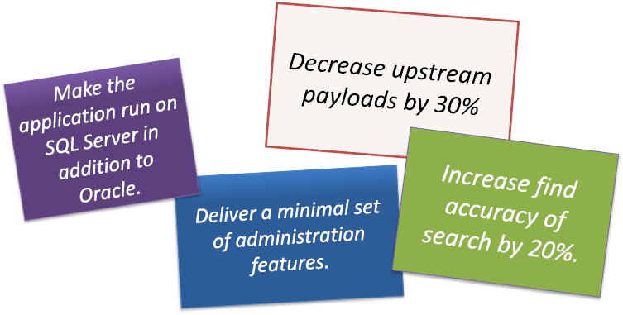
ORIGINAL SCRUM FRAMEWORK
WHAT ‘S sprint goal?
A Sprint’s Goal is fixed and may not change

Slide 30
ORIGINAL SCRUM FRAMEWORK
Sprint Planning Meeting (part 2)
Purpose: The Development Team determines how to do the work selected in part 1
Outcome: Sprint Backlog
Activities:
The Development Team probably starts by thinking on the design for what it thinks it can do. And proceeds with how it will develop the design.
The Sprint Backlog is the selected Product Backlog and a plan for delivering it.
The Product Owner may be required to clarify and make design tradeoff’s. Product Backlog may be returned or additional Product Backlog requested by the Development Team.

Slide 31
ORIGINAL SCRUM FRAMEWORK
WHAT ‘S sprint BACKLOG?
Selected Product Backlog items and a plan to deliver them are the Sprint Backlog.
Product Backlog Items are often decomposed as acceptance tests.
Larger items may be decomposed later, during the Sprint itself.
Work for the Sprint emerges.
Work remaining is updated daily.
Development Team members may modify the Sprint Backlog anytime.

Slide 32
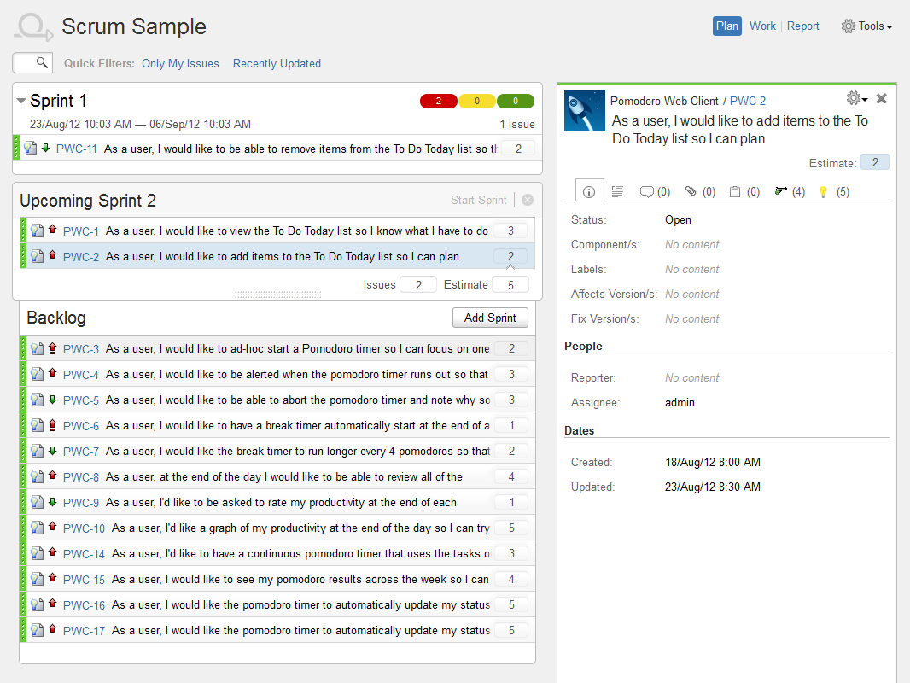
ORIGINAL SCRUM FRAMEWORK
Sprint BACKLOG SAMPLE

Slide 33

ORIGINAL SCRUM FRAMEWORK
DAILY SCRUM
Three questions provide grist for inspecting progress
Inspect progress toward the Sprint Goal
15 minute daily meeting
Consistent place and time

Slide 34

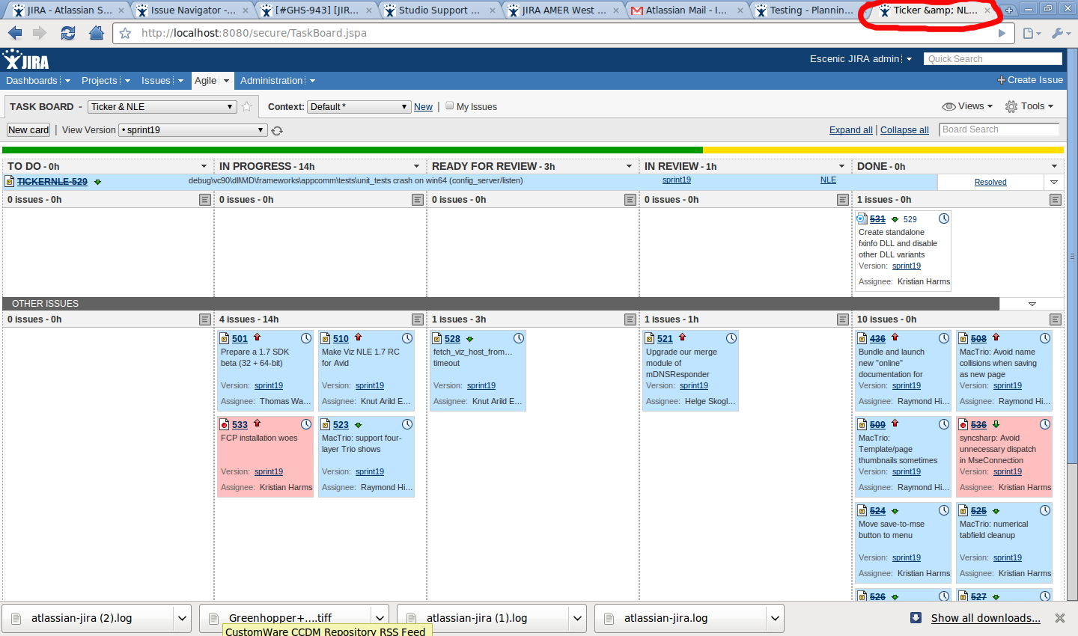
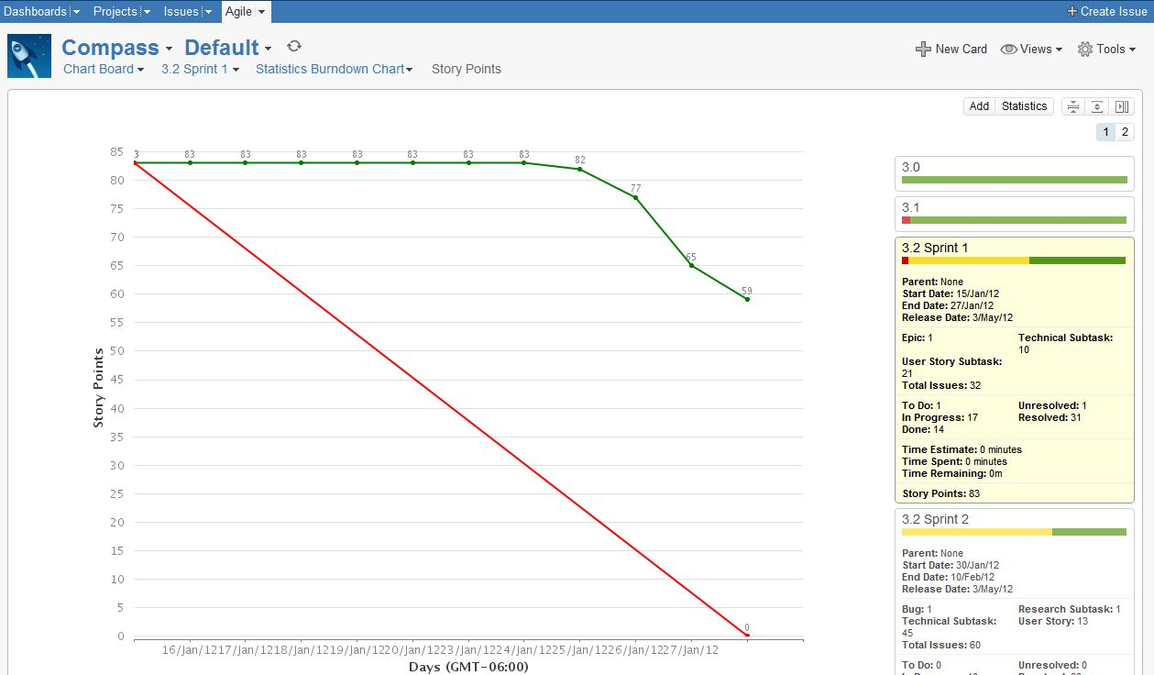
ORIGINAL SCRUM FRAMEWORK
Monitoring Sprint Progress

Slide 35

ORIGINAL SCRUM FRAMEWORK
SPRINT REVIEW
Purpose: Scrum Team and stakeholders inspect the Increment
Outcome: Updated Product Backlog
Activities:
Restore undone Product Backlog,
Rearrange Product Backlog,
Reformulate development team,
Add more Scrum Teams,
Release one or more increments of functionality
Transparency is required;
The Increment must be Done, i.e. potentially shippable, or usable by stakeholders

Slide 36

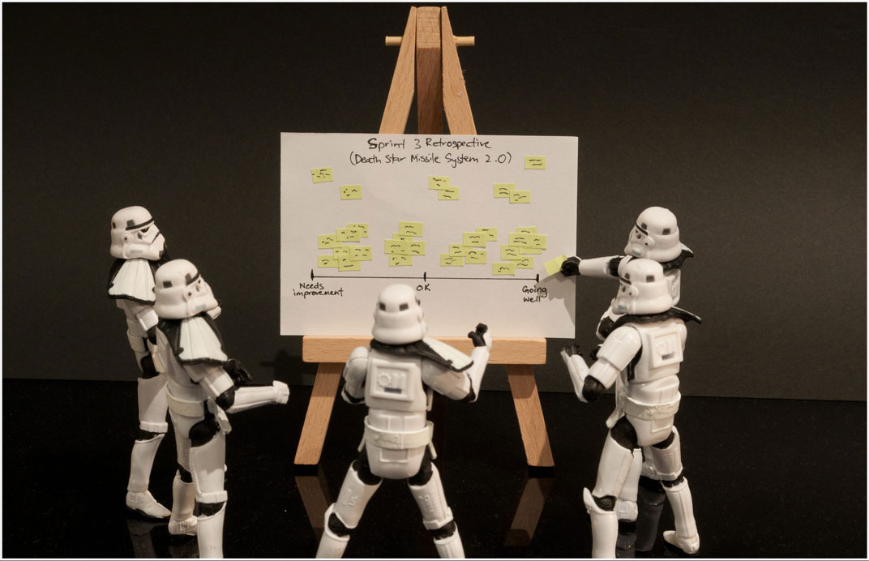
ORIGINAL SCRUM FRAMEWORK
Sprint Retrospective
Scrum Team inspects how the last Sprint went
Scrum Team selects actionable improvements
Scrum Team implements improvements for next Sprint(s)

Slide 37


ORIGINAL SCRUM FRAMEWORK
Definition of “Done”
Have a complete Definition of Done that mirrors “ready to ship”
Ensure that the Definition of Done optimizes maintainability, sustainability and enhanceability
Adhere to done at least every Sprint
Adhere more often than every Sprint to avoid surprises at Sprint end
Done is for the entire product, not just for a Scrum Team’s Increment
As Scrum Teams mature, definition of “Done” will expand to include more criteria for higher quality

Slide 38
SUMMARY & DISCUSSION
“A round man cannot be expected to fit in a square hole right away. He must have time to modify his shaped.
- Mark Twain

Slide 39
SUMMARY & DISCUSSION
DO YOU HAVE A CORRECT ANSWER ?
 | True | False
Agile teams do very little planning |  | ✓
Agile is not suited for fixed bid projects |  | ✓
Models like PMI and PRINCE2 are more suited to high-risk projects than agile | ✓
Developers do not have the people skills needed to talk to customers |  | ✓
Moving people between projects helps spread expertise and improves the organization |  | ✓
Agile teams don’t create documentation |  | ✓
Some people need to be told what to do |  | ✓
Scrum meetings be replaced by emailed status reports |  | ✓
In SCRUM, we can change anytime we want |  | ✓

Slide 40

SUMMARY & DISCUSSION
Common Failures with Scrum
Misunderstanding what Scrum is (and is not)
Software not tested at end of sprint (definition of Done)
Backlog not ready at beginning of sprint (definition of Ready)
Lack of facilitation or bad facilitation
Lack of management support
Lack of client, customer, or end user support

Slide 41
SUMMARY & DISCUSSION
Questions to Ask when Choosing AGILE
Will the user(s) participate in the project?
It is critical that the customer should spend time with the project team to help define the requirements as well as accept each deliverable throughout the entire project
Does the team have the best, the most experienced and disciplined software developers?
Team members must fulfill many roles and be willing to step in as needed to achieve the desired levels of performance and quality
Is the work environment centrally located or distributed?
This method is designed for a small group of people working together in a environment where everybody shares information & knowledge to achieve a common goal.
Does the team receive team-work training?
The nature of the AGILE method is self-organizing, self-empowering so that it is essential for team members to openly and freely share information and solution.
Does the team continuously learning new things?
These retrospectives will allow the team to modify their process to improve on the next sprint(s) and ensure the project success.

Slide 42
SUMMARY & DISCUSSION
Are You Using Scrum?
Is there a recognized Product Owner?
Is there a Development Team with 3 to 9 members?
Is there a Scrum Master?
Is there an ordered Product Backlog?
Is there a Sprint Backlog that shows remaining work in the Sprint?
Is each Sprint 1 month or less in duration?
Is a potentially releasable product Increment produced each Sprint?
Does the Scrum Team create a plan for the Sprint in a Sprint Planning Meeting?
Does the Development Team create a plan each day at a Daily Scrum?
Is the Increment inspected by stakeholders at a Sprint Review?
Does the Scrum Team conduct a Sprint Retrospective each Sprint?

Slide 43

SUMMARY & DISCUSSION
Scrum Is Like Your Mother-In-Law
She knew her son or daughter could have married better. She intends to help you be good enough.
By adopting Scrum, you have just invited her to come live with you.

Slide 44

SUMMARY & DISCUSSION
Scrum is small, simple. Using it can be hard

Slide 45

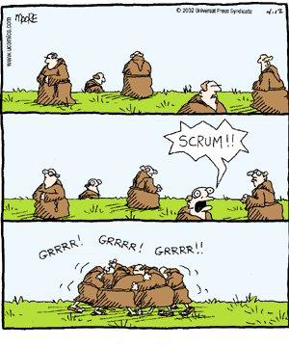
SUMMARY & DISCUSSION
discussion

Slide 46
SUMMARY & DISCUSSION
Self-Check Quiz
Which statement best describes the Sprint Review?
It is a review of the team's activities during the Sprint.
It is when the Scrum Team and stakeholders inspect the outcome of the Sprint and figure out what to do in the upcoming Sprint.
It is a demo at the end of the Sprint for everyone in the organization to provide feedback on the work done.
It is used to congratulate the Development Team if it did what it committed to doing, or to punish the Development Team if it failed to meet its commitments.
The Scrum Master is responsible for what? (multichoice)
Ensuring that the Development Team IS managed
Running the Daily Scrum
Tracking Development Team Status
Ensuring that Scrum is enacted
Ensuring that Scrum is understood

Slide 47
SUMMARY & DISCUSSION
Self-Check Quiz
A Scrum Master is keeping a list of open impediments, but it is growing and he/she has been able to resolve only a small portion of the impediments. Which three techniques would be most helpful in this situation?
Prioritize the list and work on them in order.
Alert management to the impediments and their impact.
Arrange a triage meeting with all other project managers.
Discuss the absence of management support with the Development Team.
Tell the Product Owner that Scrum isn't working.
Consult with the Development Team.

Slide 48
SUMMARY & DISCUSSION
Self-Check Quiz
What is the result of Sprint Review?
A completed Sprint Backlog
Critique on the development product Increment
Critique on the Development Team
The Scrum Master's documentation on the Sprint statistics
A revised Product Backlog
The Sprint Goal is devised before the sprint-backlog
True
False

Slide 49
SUMMARY & DISCUSSION
Self-Check Quiz
Who is responsible for updating the work estimates during a Sprint?
The Development Team.
The Scrum Master.
The Product Owner.
The most junior member of the Team.
An abnormal termination of a Sprint is called when?
When it is clear at the end of a Sprint that everything won't be finished.
When the Team feels that the work is too hard.
When Sales has an important opportunity.
When the Product Owner determines that it makes no sense to finish it.

Slide 50
SUMMARY & DISCUSSION
Self-Check Quiz
Who has the last say on the order of the Product Backlog?
The Stakeholders
The Development Team
The Scrum Master
The Product Owner
The Product Backlog is ordered by:
Small items at the top to large items at the bottom.
Safer items at the top to riskier items at the bottom.
Least valuable items at the top to most valuable at the bottom.
Whatever is deemed most appropriate by the Product Owner.
Development Team membership should change:
Every Sprint to promote shared learning.
Never, because it reduces productivity.
As needed, while taking into account the short term reduction in productivity.
Just as it would on any development team, with no special allowance for changes in productivity.

Slide 51
SUMMARY & DISCUSSION
Self-Check Quiz
Which two (2) things does the Development Team NOT do during the first Sprint?
Deliver an increment of potentially shippable functionality.
Nail down the complete architecture and infrastructure.
Develop and deliver at least one piece of functionality.
Develop a plan for the rest of the project.
What is the primary way a Scrum Master keeps a Development Team working at its highest level of productivity?
By facilitating Development Team decisions and removing impediments.
By ensuring the meetings start and end at the proper time.
By preventing changes to the Backlog once the Sprint begins.
By keeping high value features high in the Product Backlog.

Slide 52
SUMMARY & DISCUSSION
Self-Check Quiz
It is important that the product increment be released to production or shipped to customers at the end of each Sprint?
True
False
When is a Sprint over?
When all Product Backlog items meet their definition of done.
When the Product Owner says it is done.
When all the tasks are completed.
When the timebox expires
The CEO asks the Development Team to add a "very important" item to the current Sprint. What should the Development Team do?
Add the item to the current Sprint without any adjustments.
Add the item to the current Sprint and drop an item of equal size.
Add the item to the next Sprint.
Inform the Product Owner so he/she can work with the CEO

Slide 53
THANK YOU
“I am a firm believer in the people. If given the truth, they can be depended upon to meet any [software development] challenge. The great point is to bring them the real facts.”
Abraham Lincoln

